Slide 1
Data Structures 資料結構
Trees – Part II
Department of Computer Science
National Tsing Hua University

Slide 2
Binary tree applications

Slide 3
Expression Tree
Given a regular expression, put operands at leaf nodes and operators at nonterminal nodes
*
+
+
y
-
a
b
z
+
E1
E2
x
10
E1 + E2
a + b
y * (z – (x + 10))
Infix notation
Inorder
Preorder
Postorder
+ E1 E2
+ a b
* y – z + z 10
Prefix notation
E1 E2 +
a b +
y z x 10 + - *
Postfix notation

Slide 4
Priority Queue
In a priority queue, the element to be processed/deleted is the one with highest (or lowest) priority
Operations
Get the max/min element
Insert an element to the priority queue
Delete element with max/min priority

Slide 5
ADT : Priority Queue
template < class T >
class MaxPQ
{
public:
MaxPQ();
~MaxPQ();
// Check if PQ is empty
bool IsEmpty() const;
// Return reference to the max element
T& Top() const;
// Add an element to the PQ
void Push(const T&);
// Delete element with max priority
void Pop();
private:
// Data representation here
// …
};

Slide 6
PQ Representations
Unsorted linear list
Array, chain,..,etc
Sorted linear list
Sorted array, sorted chain,…,etc
Heap
 | Top() | Push() | Pop()
Unsorted linear list
Sorted linear list
Heap
O(n)
O(1)
O(n)
O(1)
O(n)
O(1)
O(1)
O(logn)
O(logn)

Slide 7
Max Heap
Definition: A max (min) tree is a tree in which the key value in each node is no smaller (larger) than the key values in its children (if any). A max (min) heap is a complete binary tree that is also a max (min) tree.
14
30
12
7
14
25
10
8
6
Max Heap
Max Heap
Max/Min Heap

Slide 8
Max Heap
Definition: A max (min) tree is a tree in which the key value in each node is no smaller (larger) than the key values in its children (if any). A max (min) heap is a complete binary tree that is also a max (min) tree.
14
14
10
7
12
7
12
8
6
8
6
Not a heap
(12 > 10)
Not a heap
(Not a complete binary tree)

Slide 9
Max Heap : Representation
Since the heap is a complete binary tree, we could adopt “Array Representation” as we mentioned before!
Let node i be in position i (array[0] is empty)
Parent(i) = i / 2 if i ≠ 1. If i=1, i is the root and has no parent.
leftChild(i) = 2i if 2i ≤ n. If 2i > n, the i has no left child.
rightChild(i) = 2i+1 if 2i+1 ≤ n, if 2i+1 > n, the i has no right child.

Slide 10
ADT : Priority Queue
template < class T >
class MaxPQ
{
public:
MaxPQ();
~MaxPQ();
// Check if PQ is empty
bool IsEmpty() const;
// Return reference to the max element
T& Top() const;
// Add an element to the PQ
void Push(const T&);
// Delete element with max priority
void Pop();
private:
T* heap // Element array
int heapSize; // # of elements
int capacity; // size of the array “heap”
};

Slide 11
Max Heap : Insert
Insert (5)
Make sure it is a complete binary tree
Check if the new node is greater than its parent
If so, swap two nodes
20
15
2
14
10
5

Slide 12
Max Heap : Insert
Insert (5)
Make sure it is a complete binary tree
Check if the new node is greater than its parent
If so, swap two nodes
20
15
5
14
10
2

Slide 13
Max Heap : Insert Codes
template < class T >
void MaxPQ<T>::Push(const T& e)
{ // Insert e into max heap
// Make sure the array has enough space here…
// …
int currentNode = ++heapSize;
while(currentNode != 1 && heap[currentNode/2] < e)
{ // Swap with parent node
heap[currentNode]=heap[currentNode/2];
currentNode /= 2; // currentNode now points to parent
}
heap[currentNode]=e;
}
Time Complexity Travel at most the height of a tree, therefore is O(logn)

Slide 14
Max Heap : Delete
Always delete the root
Move the last element to the root ( maintain a complete binary tree )
20
16
15
12
8

Slide 15
Max Heap : Delete
Always delete the root
Move the last element to the root ( maintain a complete binary tree )
Swap with larger and largest child (if any)
8
16
15
12

Slide 16
Max Heap : Delete
Always delete the root
Move the last element to the root ( maintain a complete binary tree )
Swap with larger and largest child (if any)
Continue step 3 until the max heap is maintained (trickle down)
16
8
15
12

Slide 17
Max Heap : Delete
Always delete the root
Move the last element to the root ( maintain a complete binary tree )
Swap with larger and largest child (if any)
Continue step 3 until the max heap is maintained (trickle down)
16
12
15
8

Slide 18
Max Heap : Delete Codes
template < class T >
void MaxPQ<T>::Pop()
{ //Delete max element
if(IsEmpty()) throw “Heap is empty”;
heap[1].~T(); // delete max element (always the root!)
// Remove the last element from heap
T lastE = heap[heapSize--];
// trickle down
int currentNode = 1; // root
int child = 2; // A child of currentNode
while(child <= heapSize) {
// Set child to larger child of currentNode
if (child < heapSize && heap[child] < heap[child + 1]) child++;
// Can we put lastE in currentNode?
if (lastE >= heap[child]) break; // Yes!
// No!
heap[currentNode] = heap[child]; // Move child up
currentNode = child; child *=2; // Move down a level
}
heap[currentNode] = lastE;
}
Time Complexity = Height of tree = O(logn)

Slide 19
Binary Search Tree
Definition: A binary search tree (BST) is a binary tree which satisfies the following properties:
Every element has a key and no two elements have the same key.
The keys (if any) in the left subtree are smaller than the key in the root
The keys (if any) in the right subtree are larger than the key in the root
The left and right subtrees are also BST

Slide 20
BST: Examples
20
30
15
25
5
40
12
10
22
2
39
42
NO!
YES!
Inorder traversal?
Inorder traversal of a BST will result in a sorted list

Slide 21
BST : Operations
Search an element in a BST
Search for the r^{th} smallest element in a BST
Insert an element into a BST
Delete max/min from a BST
Delete an arbitrary element from a BST

Slide 22
BST : Search an Element
Search for key 7
Start from root
Compare the key with root
‘<’ search the left subtree
‘>’ search the right subtree
Repeat step 3 until the key is found or a leaf is visited
60
5
2
7

Slide 23
BST : Recursive Search Codes
template < class K, class E >
pair<K,E>* BST<K,E>::Get(const K& k)
{ // Search the BST for a pair with key k
// If the this pair is found, return a pointer to this // pair, otherwise return 0
return Get(root, k);
}
template < class K, class E >
pair<K,E>* BST<K,E>::Get(TreeNode<pair<K,E>>* p, const K& k)
{
if(!p) return 0;
if(k < p->data.first) return Get(p->leftChild, k);
if(k > p->data.first) return Get(p->rightChild, k);
return &p->data;
}
p->data.first = key
p->data.second = element

Slide 24
BST : Iterative Search Codes
template < class K, class E >
pair<K,E>* BST<K,E>::Get(const K& k)
{
TreeNode < pair<K, E> > *currentNode = root;
while (currentNode) {
if (k < currentNode->data.first)
currentNode = currentNode->leftChild;
else if (k > currentNode->data.first)
currentNode = currentNode->rightChild;
else return & currentNode->data;
}
return NULL; // no match found
}

Slide 25
BST : Search an Element by Rank
Definition of rank:
A rank of a node is its position in inorder traversal
30
Need r visits of nodes
Any faster ways?
5
40
2
Inorder traversal : 2 -> 5 -> 30 -> 40
Rank : 1 2 3 4
Therefore, the r^{th} smallest element is the node with rank r

Slide 26
BST: Search by Rank - leftSize
To facilitate searching for rank-r element, we store the additional information, leftSize
leftSize = 1 + # of nodes in left subtree
5
30
4
5
2
40
2
2
1
35
1
80
1
1
1
3

Slide 27
BST: Search by Rank - leftSize
If we are searching for the rank-r element, we perform:
Set currentNode = root
Consider 3 cases
leftSize > r: currentNode = left child; repeat 2)
leftSize < r: r = r – leftSize; currentNode = right child, repeat 2)
leftSize = r: bingo; break
5
30
4
5
2
40
2
2
1
35
1
80
1
1
1
3

Slide 28
BST: Search by Rank - leftSize
If we are searching for the rank-r element, we perform:
Set currentNode = root
Consider 3 cases
leftSize > r: currentNode = left child; repeat 2)
leftSize < r: r = r – leftSize; currentNode = right child, repeat 2)
leftSize = r: bingo; break
5
30
Example: r=3
4
5
2
40
2
2
1
35
1
80
1
1
1
3

Slide 29
BST: Search by Rank - leftSize
If we are searching for the rank-r element, we perform:
Set currentNode = root
Consider 3 cases
leftSize < r: currentNode = left child; repeat 2)
leftSize > r: r = r – leftSize; currentNode = right child, repeat 2)
leftSize = r: bingo; break
5
30
Example: r=7
4
5
2
40
2
2
1
35
1
80
1
1
1
3

Slide 30
BST: Search by Rank - leftSize
If we are searching for the rank-r element, we perform:
Set currentNode = root
Consider 3 cases
leftSize > r: currentNode = left child; repeat 2)
leftSize < r: r = r – leftSize; currentNode = right child, repeat 2)
leftSize = r: bingo; break
5
30
Example: r=6
4
5
2
40
2
2
1
35
1
80
1
1
1
3

Slide 31
BST : Search by Rank Codes
For each node, we store an additional information “leftSize” which is 1 + (# of nodes in the left subtree)
template < class K, class E >
pair<K,E>* BST<K,E>::RankGet(int r)
{ // Search BST for the rth smallest pair
TreeNode<pair<K,E>>* currentNode = root;
while(currentNode){
if(r < currentNode->leftSize)
currentNode = currentNode->leftChild;
else if(r > currentNode->leftSize) {
r -= currentNode->leftSize;
currentNode = currentNode->rigthChild;
}
else return &currentNode->data;
}
return 0;
}

Slide 32
Question
The r^{th} smallest element is the node with rank r
What if we want to retrieve the r^{th} largest element?
We can add a variable rightSize
Or, we can simply perform a transformation …
Notes:
n = total keys
rth largest = n-r+1

Slide 33
BST : Insert
To insert an element with key 80
First we search for the existence of the element
If the search is unsuccessful, then the element is inserted at the point the search terminates
30
5
40
2
80

Slide 34
BST : Insert Codes
template < class K, class E >
void BST<K,E>::Insert(const pair<K,E>& thePair)
{ // Search for key “thePair.first”, pp is the parent of p
TreeNode<pair<K,E>>* p = root, *pp=0;
while(p){
pp = p;
if(thePair.first < p->data.first)
p = p->leftChild;
else if(thePair.first > p->data.first)
p = p->rightChild;
else // Duplicate, update the value of element
{ p->data.second = thePair.second; return; }
}
// Perform the insertion
p = new pair<K,E>(thePair);
if(root) // tree is not empty
if(thePair.first < pp->data.first) pp->leftChild = p;
else pp->rightChild = p;
else root = p;
}

Slide 35
BST : Delete
Min (Max) element is at the leftmost (rightmost) of the tree
Min or max are not always terminal nodes
Min or max has at most one child
5
5
Max
Max
2
7
3
7
Min
Min
1
3
1
4
6
4
2

Slide 36
BST : Delete
To delete an element with key k
Search for the key k
If the search is successful, we have to deal three scenarios
The element is a leaf node
The element is a non-leaf node with one child
The element is a non-leaf node with two children

Slide 37
BST : Delete
Scenario 1 : The element is a leaf node
The child field of parent node is set to NULL
Dispose the node
To delete 35
30
5
40
2
35
80
1
3

Slide 38
BST : Delete
Scenario 2 : The element is a non-leaf node with one child
Simply change the pointer from the parent node (i.e. node with key 30) to the single-child node (i.e. node with key 2)
Dispose the node
30
To delete 5
5
40
2
80
1
3

Slide 39
BST : Delete
Scenario 2 : The element is a non-leaf node with one child
Simply change the pointer from the parent node (i.e. node with key 30) to the single-child node (i.e. node with key 2)
Dispose the node
30
To delete 5
2
40
1
3
80

Slide 40
BST : Delete
Scenario 3 : The element is a non-leaf node with two children
The deleted element is replaced by either
the smallest element in right subtree or
the largest element in left subtree
30
To delete 30
5
40
7
35
41
6
The smallest element in right subtree

Slide 41
BST : Delete
Scenario 3 : The element is a non-leaf node with two children
Delete the node
It is a leaf node -> apply scenario 1!
35
To delete 30
5
40
7
35
41
6

Slide 42
BST : Delete
Scenario 3 : The element is a non-leaf node with two children
The deleted element is replaced by either
the smallest element in right subtree or
the largest element in left subtree
30
To delete 30
5
40
The largest element in left subtree
7
35
41
6

Slide 43
BST : Delete
Scenario 3 : The element is a non-leaf node with two children
Delete the node
It is a non-leaf node with one child -> apply scenario 2!
7
To delete 30
5
40
7
35
41
6

Slide 44
BST : Delete
Scenario 3 : The element is a non-leaf node with two children
Delete the node
It is a non-leaf node with one child -> apply scenario 2!
7
To delete 30
5
40
6
35
41

Slide 45
BST : Time Complexity
Search, insertion, or deletion takes O(h)
h = Height of a BST
Worst case h=n
Insert keys
Best case h=logn
Insert keys : 4, 2, 6, 1, 3, 5, 7
1,
2,
3,
…
1
4
2
2
6
3
1
3
5
7
n

Slide 46

Self-Study Topics
Write pseudo codes of BST deletion
Selection trees
AVL/Red-Black trees (Chapter 10)
Worst case height : O(logn)

Slide 47
forests

Slide 48
Forests
Definition : A forest is a set of n ≥ 0 disjoint trees.
Operations :
Transforming a forest to binary tree
Forest traversals
A
E
G
B
C
D
F
H
I
Three-tree forest

Slide 49
Transforming a Forest to Binary Tree
Apply left child-right sibling approach
Convert each tree into binary tree
Connect two binary trees, T₁ and T₂, by setting the rightChild of root(T₁) to the root(T₂)
A
E
G
B
C
D
F
H
I

Slide 50
Transforming a Forest to Binary Tree
Apply left child-right sibling approach
Convert each tree into binary tree
Connect two binary trees, T₁ and T₂, by setting the rightChild of root(T₁) to the root(T₂)
A
B
E
C
F
G
D
H
I

Slide 51
Forest Traversals
Assume we have a forest F and corresponding binary tree T, then
Preorder (inorder) traversal of T is equivalent to visiting the nodes of F in forest preorder (inorder)

Slide 52
Forest Preorder Traversal
Preorder traversal of binary tree
A B C D E F G H I
Preorder traversal of forest
Root: A
Left forest: B C D
Right forest: E F G H I
Root
A
B
E
C
F
G
H
D
I
Left forest
Right forest

Slide 53
Disjoint Sets
Assume a set S of n integers {0, 1, 2,…, n-1} is divided into several subsets S₁, S₂, … , S_{k} and S_{i}∩ S_{j} = ф for any i, j є { 1, … , k } and i ≠ j
Operations:
Disjoint set union : Union(S_{i}, S_{j})
S_{i} = S_{i} U S_{j} or S_{j} = S_{i} U S_{j}
Find the set containing element x : Find(x)

Slide 54
Disjoint Sets : Example
Set
S = { 0,1, 2, 3, 4, 5 }
Disjoint subsets
S₁ = { 0, 2, 3 }
S₂ = { 1 }
S₃ = { 4, 5 }
Union(S₁, S₂) = { 0, 1, 2, 3 }
Find(5) = 3

Slide 55
DS: Array Representation
S = { 0, 1, 2, 3, 4, 5 } with subsets
S₁ = { 0, 2, 3 }, S₂ = { 1 } and S₃ = { 4, 5 }
Using a sequential mapping array where index represents set members and array value indicates set name
Set name
1
2
1
1
3
3
Set member
S[0] S[1] S[2] S[3] S[4] S[5]

Slide 56
DS Operation: Find(x)
Find the set which contains element x is easy
Find(5) = S[5] = set 3 Find(3) = S[3] = set 1
Complexity = O(1)
Set name
1
2
1
1
3
3
Set member
S[0] S[1] S[2] S[3] S[4] S[5]

Slide 57
DS Operation: Union(S_{i}, S_{j})
Assume we always merge the 2nd set to 1st set S_{i} = S_{i} U S_{j}
Scan the array and set S[k] to i if S[k]==j
S₂=Union(S₂, S₃)
Set name
1
2
1
1
3
3
Set member
S[0] S[1] S[2] S[3] S[4] S[5]
Set name
1
2
1
1
2
2
Set member
S[0] S[1] S[2] S[3] S[4] S[5]

Slide 58
DS Time Complexity
S = { 0, 1, 2, … , n-1 }
S₁ = { 0 }, S₂ = { 1 }, S₃ = { 2 }, … , S_{n} = { n-1 }
Perform a sequence Union
Union(S₂, S₁), Union(S₃, S₂), …, Union(S_{n}, S_{n-1})
(n-1)*O(n) = O(n²)
Followed by a sequence of Find
Find(0), Find(1), …, Find(n-1)
n*O(1)=O(n)
Total time complexity = O(n²)

Slide 59
DS: Tree Representation
Link elements of a subset to form a tree
Link children to root
Link root to set name
S = { 0, 1, 2, 3, 4, 5 } with subsets S₁ = { 0, 2, 3 }, S₂ = { 1 } and S₃ = { 4, 5 }
Set name
S₁
0
1
4
S₂
2
3
5
S₃
S₁
S₂
S₃

Slide 60
DS: Tree Representation
Use an array to store the tree
Identify the set by the root of the tree
T[0]
-1
Set name
T[1]
-1
S₁
0
1
4
T[2]
0
S₂
2
3
5
T[3]
0
S₃
S₁
S₂
S₃
T[4]
-1
e.g., this indicates that 5’s parent is 4
T[5]
4

Slide 61
DS Operation: Union(S_{i}, S_{j})
Set the parent field of one of the root to the other root
S₁=Union(S₁, S₃)
Time complexity : O(1)
T[0]
-1
T[1]
-1
T[2]
0
0
4
0
T[3]
0
2
3
5
2
3
4
T[4]
-1
0
S1
S3
T[5]
5
4
Notes:
為何不連在leaf -> 也成，演算法不會錯，但find時間更久

Slide 62
DS Operation: Find(x)
Following the index starting at x and tracing the tree structure until reaching a node with parent value = -1
Use the root to identify the set name
T[0]
-1
Set name
T[1]
-1
S₁
0
1
4
T[2]
0
S₂
2
3
5
T[3]
0
S₃
S₁
S₂
S₃
T[4]
-1
T[5]
4
Find(3)
= S₁

Slide 63
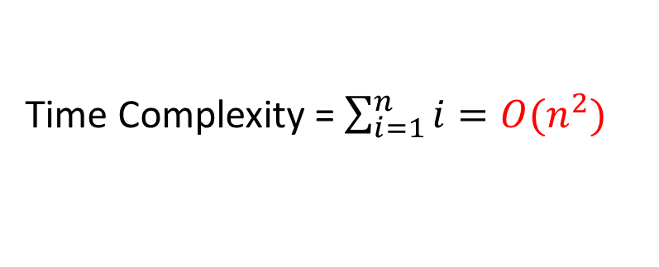
DS Time Complexity
S = { 0, 1, 2, … , n-1 }
S₁ = { 0 }, S₂ = { 1 }, S₃ = { 2 }, … , S_{n} = { n-1 }
Perform a sequence Union
Union(S₂, S₁), Union(S₃, S₂), …, Union(S_{n}, S_{n-1})
n-1
Followed by a sequence of Find
Find(0), Find(1), …, Find(n-1)
2
1
Time Complexity = $\sum_{i=1}^{n}{i}=O(n^{2})$
0

Slide 64
Improved Union(S_{i}, S_{j})
Do not always merge two sets into the first set
Adopt a Weighting rule to union operation
S_{i} = S_{i} U S_{j}, if | S_{i} | >= | S_{j} |
S_{j} = S_{i} U S_{j}, if | S_{i} | < | S_{j} |
S = { 0, 1, 2, … , n }
S₁ = { 0 }, S₂ = { 1 }, S₃ = { 2 }, … , S_{n} = { n-1 }
Union ( 1, 2 )->Union ( 1, 3 )->Union ( 1, 4 )
0
1
2
3

Slide 65
Maximum Tree Height
Lemma 5.5
Let T be a tree with m nodes created by a sequence of weighting unions. The height of T is no greater than log₂m +1
Proof
The longest length is the path that is increased by 1 in every union operation
You may check the detailed proof in page 310

Slide 66
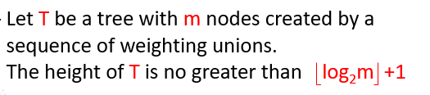
Maximum Tree Height (Proof)
Lemma 5.5
Proved with induction
Clearly true for m=1
Assume true for all trees with i nodes, i<=m-1. Now we prove that it is also true for i=m.
Let T be a tree with m nodes created by WeightedUnion. Consider the last union operation, say union(k,j). Let a be the number of nodes in tree j and m-a the number in tree k. WLOG, assume 1<=a<=m/2.

Slide 67
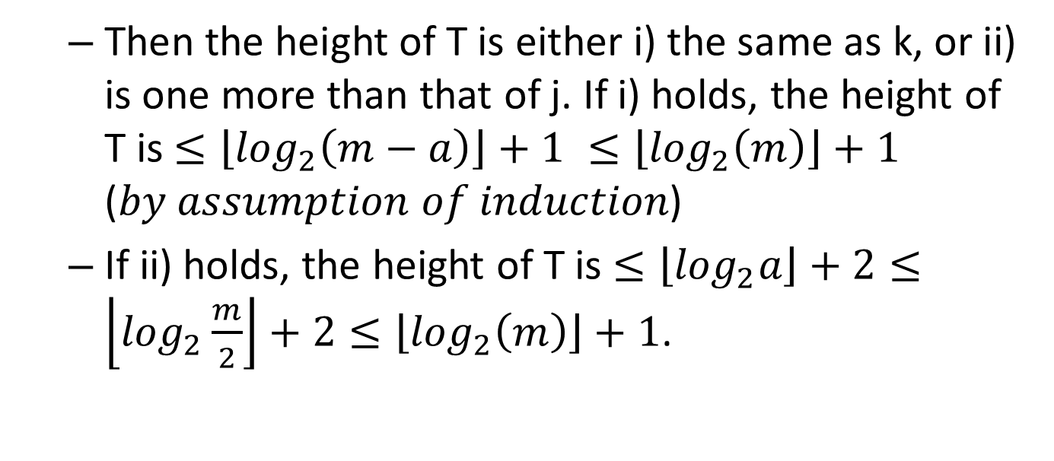
Then the height of T is either i) the same as k, or ii) is one more than that of j. If i) holds, the height of T is $≤\left\lfloor \log_{2}\left(m−a\right)\right\rfloor +1 ≤\left\lfloor \log_{2}\left(m\right)\right\rfloor +1$ (𝑏𝑦 𝑎𝑠𝑠𝑢𝑚𝑝𝑡𝑖𝑜𝑛 𝑜𝑓 𝑖𝑛𝑑𝑢𝑐𝑡𝑖𝑜𝑛)
If ii) holds, the height of T is $≤\left\lfloor \log_{2}a\right\rfloor +2≤\left\lfloor \log_{2}\frac{m}{2}\right\rfloor +2≤\left\lfloor \log_{2}\left(m\right)\right\rfloor +1$.

Slide 68
Time Complexity
The following sequence of unions produces the height of log n
Union(1, 2)
Union(3, 4)
Union(5, 6)
Union(7, 8)
Union(1, 3)
Union(5, 7)
Union(1, 5)
1
2
3
4
5
6
7
8
1
2
3
5
4
6
7
8
For (n-1) unions and n find => O(n log n)

